Slide 1
Real Time Chat Application

Slide 2
Team Members:
Pawan Kumar Sharma (2200290140107)(TL)
Pranav Chaudhary (2200290140112)
Mohd. Nazim (2200290140094)
Project Supervisor:
Mrs. Monica Kansal

Slide 3
Introduction
Welcome to our Real-Time Chat Application project, where communication meets innovation in the digital age! In a world that thrives on instant connectivity, our application aims to revolutionize how people interact online. Designed with user-friendliness and efficiency in mind, this platform provides seamless real-time messaging for individuals and groups alike.
Our project utilizes cutting-edge technologies to ensure swift message delivery and a smooth user experience. Whether you're catching up with friends, collaborating on projects with colleagues, or simply connecting with new acquaintances, our chat application offers a dynamic and intuitive interface to meet your needs.

Slide 4
With a sleek and modern design, users can easily navigate through conversations, share multimedia content, and engage in lively discussions across devices. Privacy and security are at the forefront of our development, ensuring that your data remains protected at all times.
Join us on this journey as we redefine the way people communicate online. Say goodbye to delays and hello to instant, real-time conversations with our innovative chat application. Let's chat, connect, and create unforgettable moments together!

Slide 5
Software Requirements:
Languages: JavaScript (frontend), Node.js (backend)
Frameworks/Libraries: React.js, Express.js, Socket.IO
Database: MongoDB
Authentication: JSON Web Tokens (JWT)
Styling: CSS, Bootstrap
Deployment: Docker, AWS/Heroku
Version Control: Git
Tools: NPM, RESTful API, WebSocket, ESLint, Prettier

Slide 6
Hardware Requirements:
Client-Side (for Users):
Any modern device: Computer, laptop, tablet, smartphone
Latest web browser
Server-Side:
Processor: Multi-core (e.g., Intel Core i5, AMD Ryzen 5)
RAM: Minimum 4 GB (8 GB recommended)
Storage: SSD recommended
Operating System: Linux, Windows Server, macOS Server
Database Server (if self-hosted):
Processor: Multi-core
RAM: Minimum 4 GB (8 GB recommended)
Storage: SSD for database
MongoDB installed and configured

Slide 7
Modules Description:
Authentication:
Manages user registration, login, and session security with JWT.
Chat Interface:
Enables real-time one-on-one and group messaging.
Supports emojis, file sharing, and message status updates.
User Profile:
Allows users to view and update profile details.
Includes options for profile pictures, status, and bio.
Contact Management:
Lets users add, remove, and search for contacts.
Displays online/offline status for quick communication.

Slide 8
Conclusion :
Revolutionizing online communication, our Real-Time Chat App offers instant messaging, group chats, and multimedia sharing. With a sleek interface, users enjoy seamless interactions, customizable profiles, and status updates. Stay connected with online/offline indicators and receive timely notifications. Easily search past conversations and enjoy secure encryption for privacy. Admins manage users and content effortlessly with the admin panel. Built with React.js, Node.js, and MongoDB, our app ensures cross-device compatibility and scalability. Elevate your chat experience with our innovative and secure platform. Let's connect, chat, and create unforgettable moments together!

Slide 9
Notifications:
Sends real-time alerts for new messages and updates.
Users can customize notification preferences.
Settings:
Centralizes account management and customization.
Allows users to adjust passwords, emails, and chat themes.
Admin Panel (if applicable):
Provides tools for user management and chat moderation.
Offers analytics and reporting features for administrators.
Message History:
Stores and retrieves past chat conversations.
Enables search, filtering, and access to previous messages.

Slide 10
How to serve the society ?
Connecting Communities: Offering a platform for support groups, communities, and discussions.
Mental Health Support: Providing access to counselors or resources for mental well-being.
Educational Resources: Empowering users with tutorials, workshops, and learning materials.
Community Engagement: Organizing virtual events, discussions, and fundraisers for social causes.
Awareness Promotion: Sharing news, articles, and resources on social issues and health.
Accessibility: Ensuring inclusive features for users with disabilities.
Safety and Privacy: Implementing strong measures for user security and privacy.

Slide 11
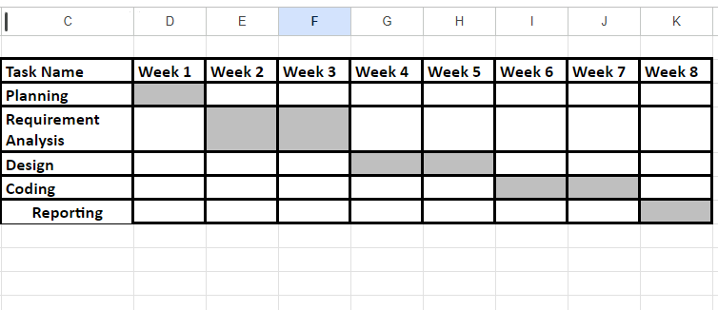
Gantt Chart:

